Slide 1
Banana Price Prediction Model for Twiga Foods
Leveraging Machine Learning for Accurate Pricing
Presented by: Charles Mulinga
Date: May 2025

Slide 2


Problem Statement
How accurately can we predict future banana prices based on historical trends and market conditions?
Twiga Foods Ltd sources bananas from smallholder farmers and distributes them across urban markets in Kenya. Accurate price forecasting allows:
Efficient procurement planning
Reduced wastage
Better pricing strategies
Our task is to build a machine learning model that uses historical price and time-based patterns to forecast banana prices.

Slide 3
Data
Source: "Twiga Foods Banana Sales" dataset
The data will be split into three categories;
Training Set – To train the model
Validation Set – to validate the trained model
Test Set – To determine model efficiency
Duration: February to April 2025.

Slide 4
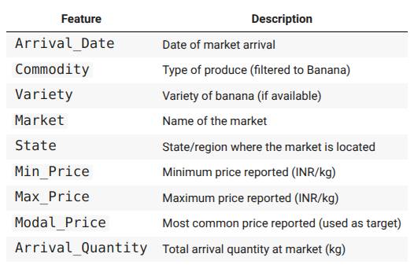
Features

Slide 5
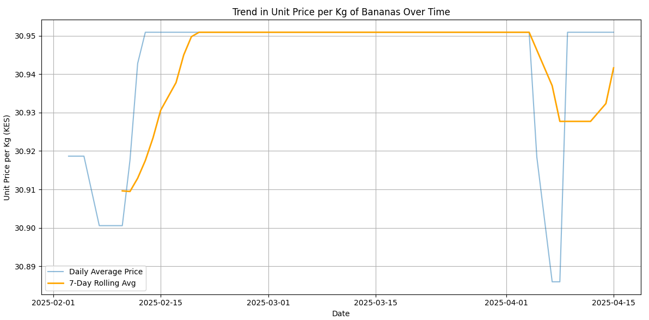
Trend in Banana Pricing
Based on the Training and Validation Data

Slide 6
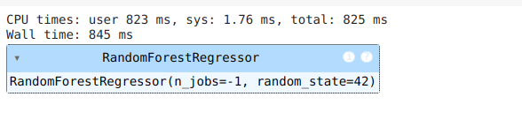
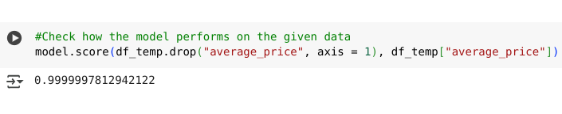
Fitting and Scoring the Model
Model fitting led to
The score; based on model.score() was

Slide 7
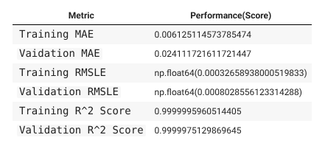
Model Evaluation (Training & Validation Sets)
We developed a custom function for model evaluation
Upon checking the desired metrics, the model scored as follows;
This implies that;
Our pricing prediction model demonstrates extremely high accuracy, with less than 3 cents error on average and an R² score of 99.999%, meaning it explains nearly all variability in banana prices. These results indicate the model is highly reliable for short-term forecasting and decision-making across different regions and dates.

Slide 8
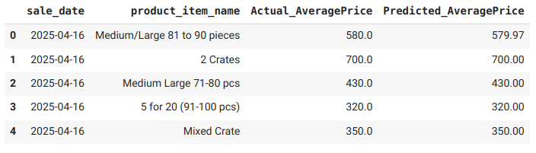
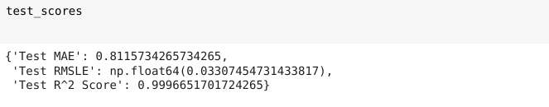
Model Predictions (Testing Set)
Scoring the model on the test set gave the following results;
This demonstrated scores as follows;

Slide 9
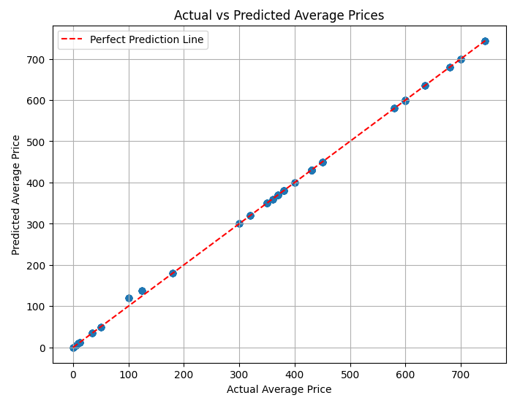
Model Performance
From the results, only a few predictions were off

Slide 10
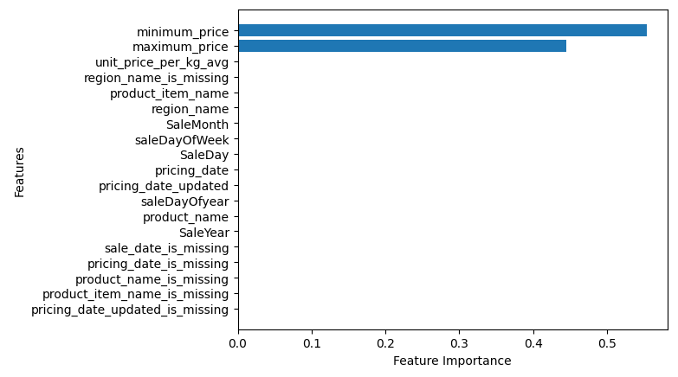
Feature Importance
Based on the given data, the important features include; minimum price and maximum price

Slide 11
📊 Summary of Model Performance
We developed a machine learning model to predict the average prices of bananas based on historical sales and pricing data.
The model was trained using a robust feature engineering process, leveraging time-based patterns and categorical encoding.
The summary model scores were;
Mean Absolute Error (MAE): 0.81
On average, the model's predicted prices deviate from actual prices by only 0.81 units, which is minimal given the typical price range.
Root Mean Squared Log Error (RMSLE): 0.033
This very low score indicates that the model predicts consistently and reliably, with minimal large deviations — even for lower-priced items.
R² Score: 0.9997
The model explains 99.97% of the variability in actual prices. This indicates a very strong predictive capability, with excellent alignment between predicted and true values.

Slide 12
What it Means for Management
The model is highly accurate and stable, making it suitable for:
Price forecasting
Inventory and procurement planning
Market trend analysis
By integrating this model into the business pipeline, management can:
Enhance decision-making around product pricing and promotions
Reduce the risk of pricing errors
Improve profitability through more precise market alignment

Slide 13
Next Steps
​Integrate the model into an analytics dashboard or pricing tool.​
Periodically retrain and evaluate the model to maintain performance as new data becomes available.​
Explore model deployment and monitoring strategies to ensure continued business value.

Slide 14
Q&A / Thank You
Thank you for your time
Questions and feedback welcome
Optional: live demo or dashboard preview

